Slide 1
CHAPTER 14: RESPIRATION IN PLANTS

Slide 2
Objectives of the chapter
To study about cellular respiration (mechanism of breakdown of food materials within the cell to study release energy).
Trapping of energy for synthesis of ATP.

Slide 4
Life processes
Life processes is a collective term for all the processes which perform the function of maintenance of life i.e. essential for survival and smooth functioning of the living organisms
1
Nutrition
2
Transportation
Four major life processes
(essential for maintenance of life)
3
Respiration
4
Excretion

Slide 5
Different modes of nutrition
Different Modes of Nutrition
Autotrophic
Heterotrophic
Photosynthetic autotrophic
(Cyanobacteria, plants, and euglena)
Chemosynthetic autotrophic
(some bacteria)
Saprophytic
(Some fungi & bacteria)
Parasitic
Holozoic
(Human and amoeba)
Ectoparasitic
(Leech, Cuscuta, etc)
Endoparasitic
(Plasmodium, tapeworm, Ascaris, )

Slide 6
Do plants breathe?

Slide 7
An Introduction to respiration
Breathing is very much connected to the process of release of energy from food.
Food is stored in the bonds of carbohydrates like glucose, sucrose and starch.
Energy required for life processes is obtained by oxidation of some macromolecules derived from food.
Site of photosynthesis in the eukaryotes: chloroplasts
Site of breakdown of complex molecules to yield energy in the eukaryotes: cytoplasm & mitochondria
Respiration = Breathing + Cellular respiration
Breathing (respiration) is the biological process of exchange of O₂ from the atmosphere with CO₂ produced by the cells.
Breathing = Inhalation/inspiration + Exhalation/Expiration
Cellular respiration
C₆ H₁₂O₆ + O₂ → Energy + CO₂ + H₂O
Glucose (Harmful)
Breaking down of glucose (simple biomolecules) inside cytoplasm or mitochondria of cells to generate energy in the form of ATP (Adenosine triphosphate).
OR
The breaking of the C-C bonds of complex compounds through oxidation within the cells, leading to release of considerable amount of energy is called respiration

Slide 8
An Introduction to respiration
The compounds that are oxidised during this process are known as respiratory substrates.
Usually carbohydrates are oxidised to release energy, but proteins, fats and even organic acids can be used as respiratory substances in some plants, under certain conditions.
During oxidation within a cell, all the energy contained in respiratory substrates is not released free into the cell, or in a single step. It is released in a series of slow step-wise reactions controlled by enzymes, and it is trapped as chemical energy in the form of ATP. Hence, it is important to understand that the energy released by oxidation in respiration is not (or rather cannot be) used directly but is used to synthesise ATP, which is broken down whenever (and wherever) energy needs to be utilised. Hence, ATP acts as the energy currency of the cell. This energy trapped in ATP is utilised in various energy-requiring processes of the organisms, and the carbon skeleton produced during respiration is used as precursors for biosynthesis of other molecules in the cell.

Slide 9
Different modes of respiration in animals
In Mitochondria
In presence of oxygen
(Aerobic respiration)
Carbondioxide + Water + Energy
In cytoplasm
In muscles of human
Lack of oxygen
(Anaerobic respiration)
Glucose
(6 carbon molecule)
Pyruvate
(3 carbon molecule + Energy)
Lactic acid + Energy
(3 carbon molecule)
In yeast
Absence of oxygen
(Anaerobic respiration)
Ethanol + Carbon dioxide + Energy
(2 carbon molecule)

Slide 10
Table Comparison between aerobic respiration and anaerobic respiration
Aerobic Respiration | Anaerobic Respiration
Aerobic respiration take place in presence of oxygen.
Anaerobic respiration occurs in absence of oxygen
It is usually occurring inside the mitochondria of cell.
It was found take place in the cytoplasm of cell.
There is complete breakdown of glucose into carbon dioxide and water takes place and produce 38 Adenosine triphosphate (ATP).
Glucose breaks down into ethyl alcohol or lactic acid, carbon dioxide, and produce less energy in the form of Adenosine triphosphate (ATP)
Aerobic organisms such as mammals follow aerobic respiration.
Anaerobic organisms like bacteria and yeast respire anaerobically. It also occurs in muscles of human during heavy activities.

Slide 11
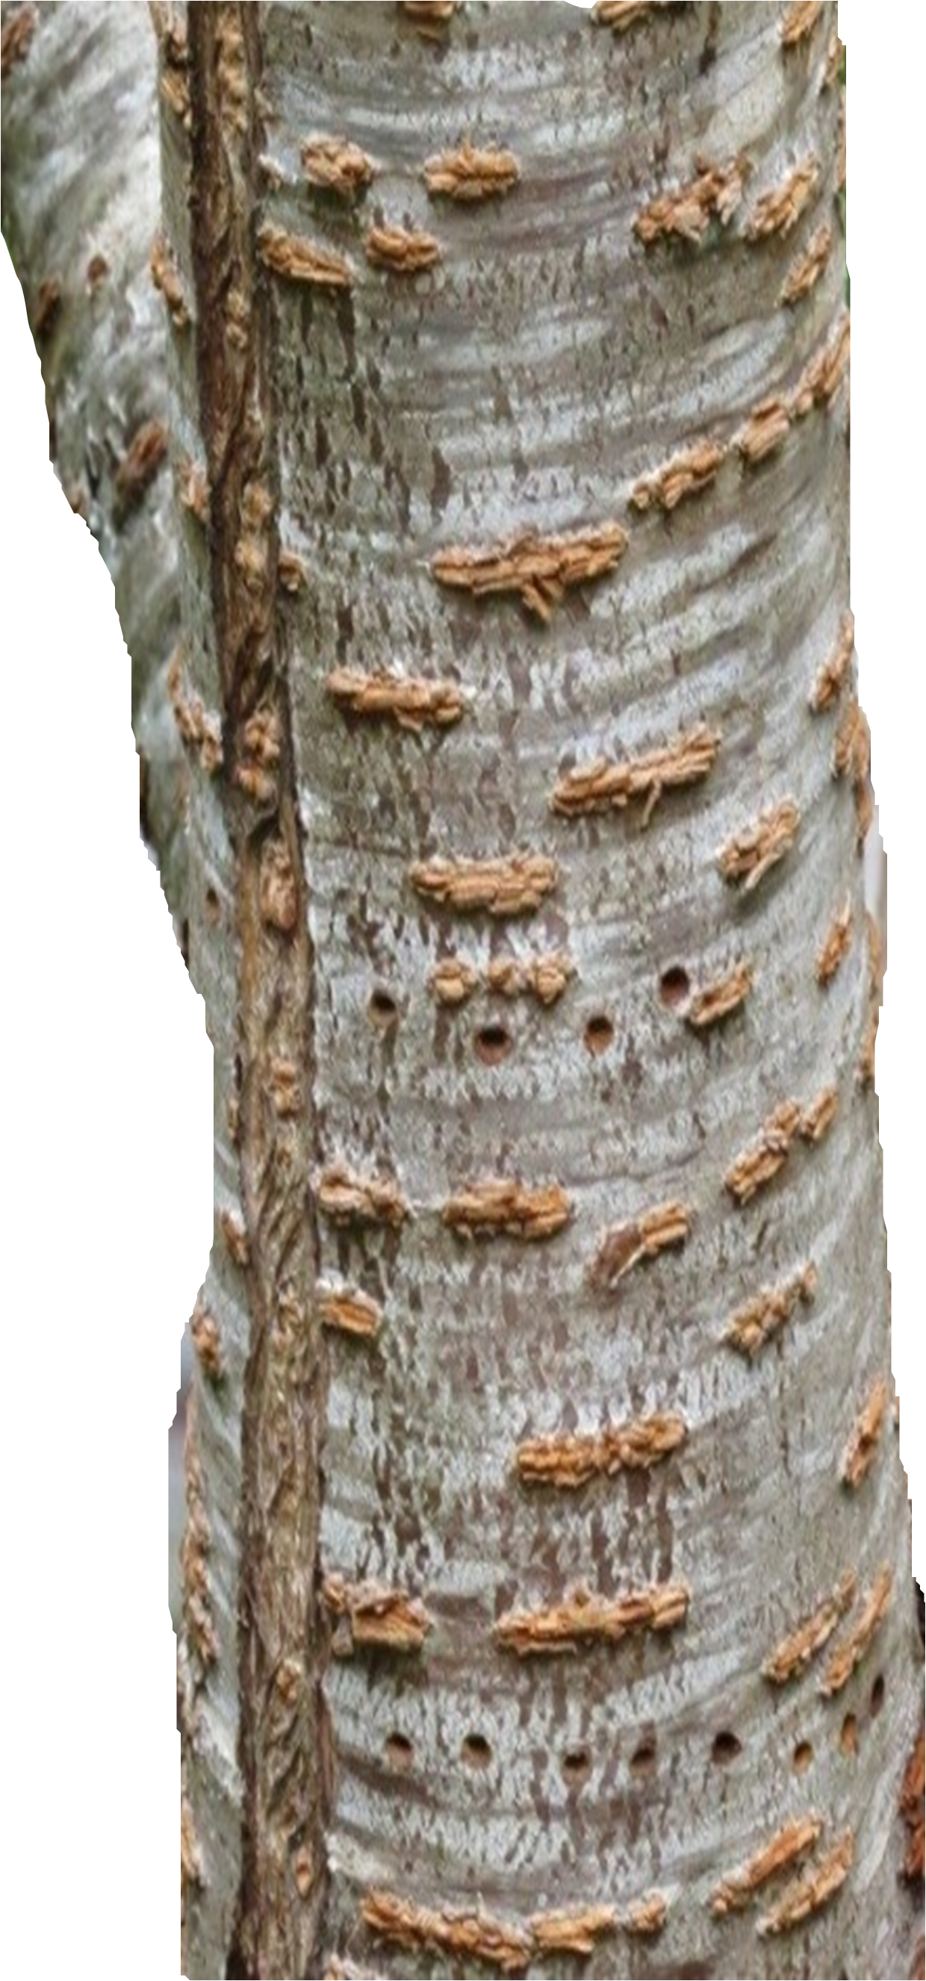

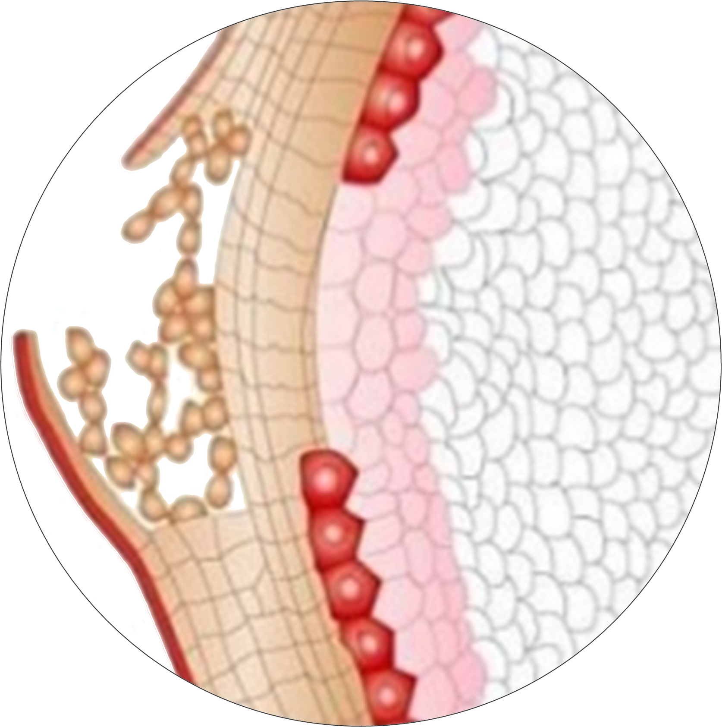

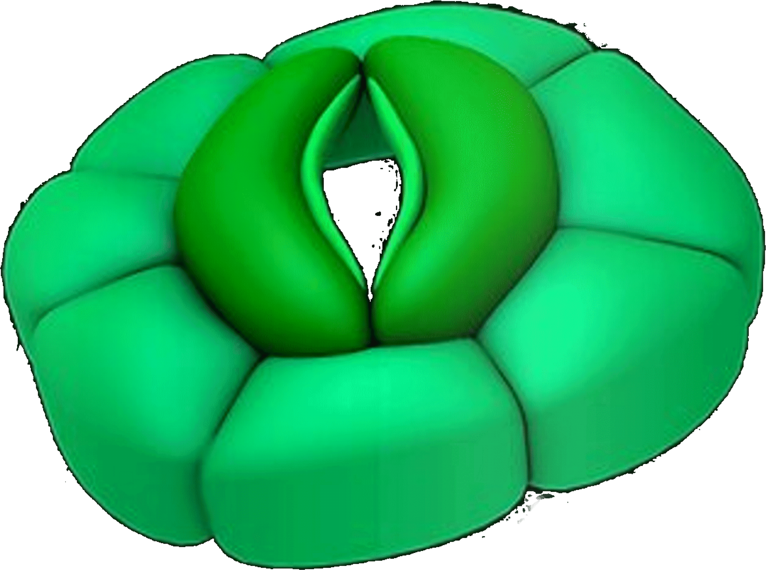
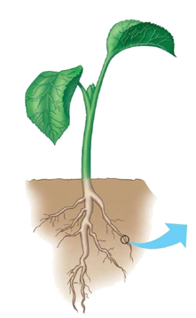
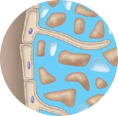
Respiration in plants
Respiration in plants is much simpler than respiration in animals.
Plants exchange respiratory gases through;
Stomata in the surfaces of leaves
Lenticels in stems
Root hair cells

Slide 12
Chapter Ends Here!

Slide 13

Teacher
Mr. Lhakpa Wangyal
PGT Biology
Email: lhakpawangyal@gmail.com
Contact number: 84497 99894
Social Baluni Public School

